Slide 1


INTRODUCTION

Slide 2

Agenda – Day 1
What is SAP UI5?
Evolution of SAP’s UI technology
Tools to develop the UI5 and Fiori apps
BAS v/s VS Code
Introduction to BTP
Creating our first project
Introduction to Client Server Architecture
Introduction to HTML
HTML5 Basics
Structure of HTML Document
Introduction to Basic HTML Tags
Form and Form Submit in HTML
Different Type of Input Field in HTML
Block Level Elements
Ordered and Unordered List in HTML
Multimedia Tags in HTML (audio, video and Iframe)
Tables in HTML

Slide 3


What is SAP UI5?
SAPUI5 is an HTML5 framework for creating cross-platform, enterprise-grade web applications in an efficient way.
SAPUI5 (SAP user interface for HTML5) is a collection of libraries that you can use to build desktop and mobile applications that run in a browser.
In simple words: SAP UI5 is a framework which is used to develop Responsive web applications to run on any platform, any browser and any OS.
Responsive web Application: It refers to the web apps that adapt different screen sizes, so the content looks great on any screen size.
Framework: A framework in programming is a tool that provides ready-made components or solutions that are customized in order to speed up development. In simple word a framework is a collection of Libraries.
Library: Collection of classes.
Classes: Collection of methods, Attributes, Events.

Slide 4
Evolution of SAP UI Technologies
Dynpro
Web Dynpro
WebGUI
BSP
SAPUI5
SAP FIORI 1.0
(2013)
SAP FIORI 2.0
(2016)
SAP FIORI 3.0
(2018)
A Small set of 25 application for tablet and phone
Desktop Scenarios
Native for iOS
More Advanced Features on the launchpad and overview pages
More Scalable content
Machine Learning Techniques Implemented
Native for Android

Slide 5
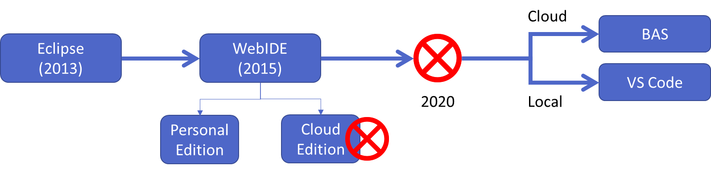
Tools to Create SAP UI5 and Fiori Apps
Deprecated

Slide 6
BAS v/s VS Code
Visual Studio Code
(VS Code)
Business Application Studio (BAS)
Pros
Lifetime free for anyone
Its an open source by Microsoft
Industry standard
Offers lots of plugins for developers
Complete local development (offline)
Cons
Acquire space in your computer
Do installation for everything needed in local machine
In case system crash, code will be gone if you have not taken any backup.
Steps
Node JS (min v16) - https://nodejs.org/en/
Download VS Code
https://code.visualstudio.com/download
3. Go to VS Code Extension and search fiori, install SAP Fiori Extension pack
Multi cloud dev tools like fiori, hana XSA, CAPM...
Pros
Trial is free for 365 days to learn BAS
No Setup required in local machine
Any device, any time, any browser
Recommended tool by sap for fiori development
Cons
Costly (BAS Costing)
Requires all time connectivity
Slow (speed depends on the internet speed)
Steps
Register free account on https://www.sap.com
Login to BTP https://account.hanatrial.ondemand.com/trial/
Click on BAS on home page and create a new dev space

Slide 7
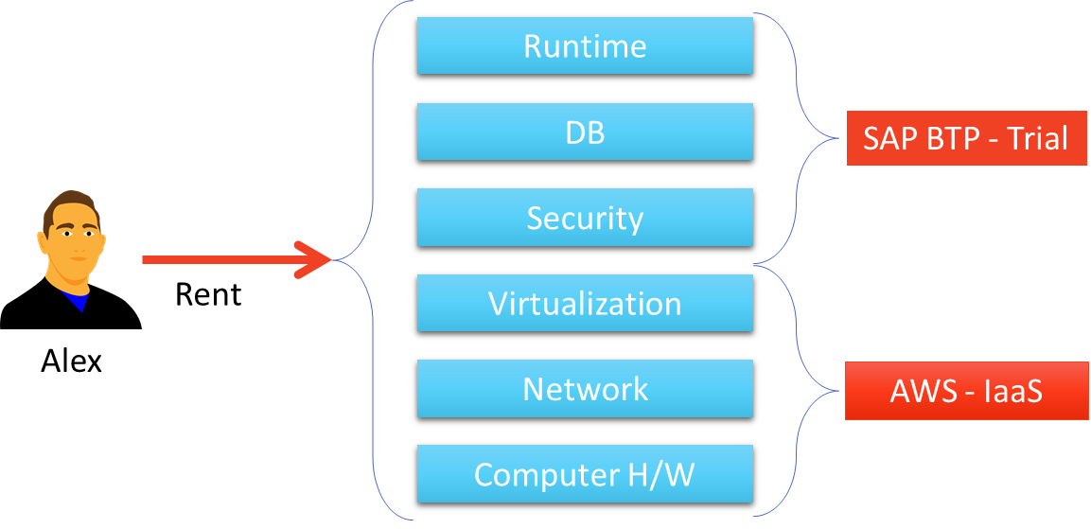
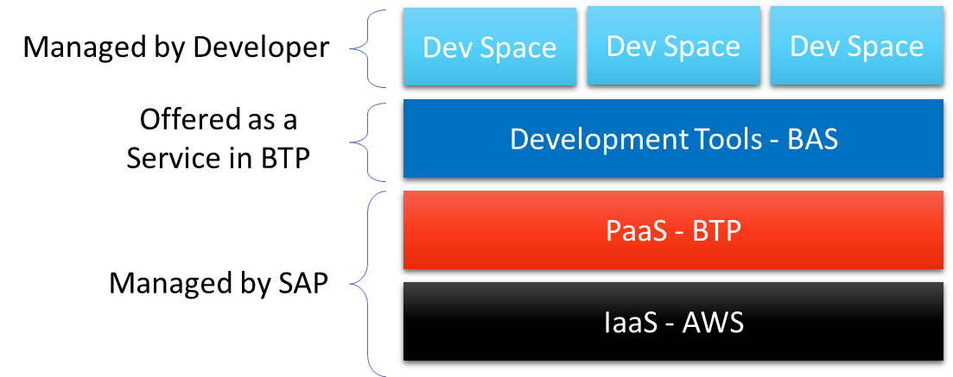
Intro to BTP - Business Technology Platform
BTP is a Platform as a Service provided by SAP to build, design, develop, test, manage end-to-end applications in cloud.
It can help develop the exact application needed quickly, easily, and economically. All this without investing in local infrastructure.
BAS is an on demand development tool provided as a service in BTP.
In BAS we can do variety of development and to achieve the same, we need to create dev space where we add the code. Actually its virtual machine running on AWS (Linux).
PaaS: Platform as a Service IaaS: Infrastructure as a Service

Slide 8
Dev Space
A dev space is a private area for a developer which confine the requirement to develop a particular application. SAP installs all the recommended tools needed to build Fiori apps in the dev space for us. Technically, it is a virtual machine running in the cloud (using Linux (Debian))
Its isolate developers work from each other
When a developer does something wrong which cause a system corruption, it wont affect other developer
In a trial a/c we can only run 2 dev space max, and one will only be running at a time
In trail account the size of a dev space can be up to 4 GB.
After starting the dev space, click on open folder and choose projects
In the projects folder create a new project
Add a index.html file with some content
Go to extensions and install Live server extension (one time)
Right click on index.html file and choose run with five server

Slide 9
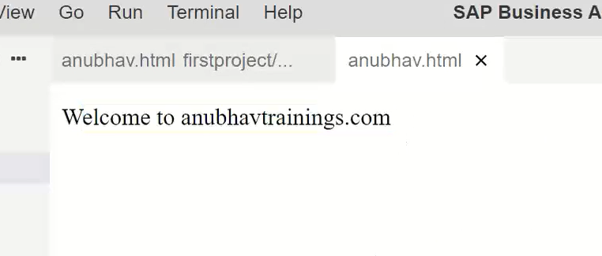
Creating First Project
Create a Page with a Button using below code:
Steps to create a Project in BAS tools:
Open the terminal window and write command mkdir firstproject this will create a folder with name firstproject in our projects directory.
Create a folder named webapp inside the new firstproject folder. We have created this folder to follow the industry standards.
Now create a file named index.html inside the webapp folder.
Now write the code in the index.html file.
Code:
<html>
<head>
</head>
<body>
Welcome to anubhavtrainings.com
</body>
</html>
You can Copy the code form here: index.html
Output:

Slide 10
Client Server Architecture
Client-server architecture is a common model in computing where a system is divided into two main components: the client and the server. These components work together to provide services, resources, or functionality to users or other systems over a network.
GET – Read Data
POST – Create new Data
PUT – Update
DELETE – Remove Data
Server
Browser
(Client)
Request – Header + Body(Optional)
Port
Response – Header + Body
(html, text, pdf, image, word, json, xml..)
Ways to make Request
Form submit
HTTP Request
Ajax Calls
DB
Request Response Architecture

Slide 11

Introduction to HTML
HTML stands for Hyper Text Markup Language.
It is used to design static web content. HTML is developed and designed by org named W3C – World Wide Web Consortium.
Markup language is used to define the text document within tag which defines the structure of web pages.
HTML5 is the fifth and current version of HTML. It has improved the markup available for documents and has introduced application programming interfaces(API) and Document Object Model(DOM).
History of HTML
W3C – World Wide Web Consortium
Is an organization and all the browser vendors (chrome, IE, Edge, Firefox) are part of it and comply to w3c standards
https://www.w3schools.com/
Year | Version
1990 | HTML
1993 | HTML 2.0
1995 | HTML 3.2
1999 | HTML4
2014 | HTML5

Slide 12
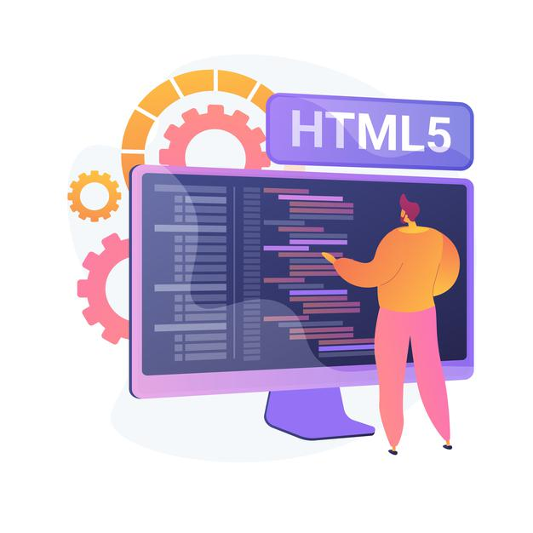
HTML Basics
All the Browsers directly understand HTML
HTML is not programming language
HTML is tag based
<tagName prop=“val” prop2=“val”>content</tagName>
All the tags are provided by – W3C – Documentation - https://www.w3schools.com/html/default.asp
Every HTML page consists of 2 parts
Header – Brain of html
Body – Content of HTML Document
HTML is a tree data structure – this is what is rendered when we execute an HTML and this runtime tree is called DOM (Document Object Model)
We can check the DOM by press F12 and going to elements section or we can right click on a web page and select the Inspect option to see the DOM.
Every HTML Element can have a id property which uniquely identifies that element on entire page.
We can also have a name property which is not unique but help us to understand the semantic meaning of the field.

Slide 13
Structure of the HTML document
<html>
<head>
<title>
</title>
</head>
<body>
</body>
</html>
This is called HTML root element and used to wrap all the code.
This contains the information about the HTML document. For Example, Title of the page, version of HTML, Meta Data etc.
This contains everything you want to display on the Web Page.
<html>: This is called HTML root element and used to wrap all the code.
<head>: Head tag contains metadata, title, page CSS etc. All the HTML elements that can be used inside the <head> element are: <style>, <title>, <base>, <noscript>, <script>, <meta>
<body>: Body tag is used to enclose all the data which a web page has from texts to links. All the content that you see rendered in the browser is contained within this element.

Slide 14
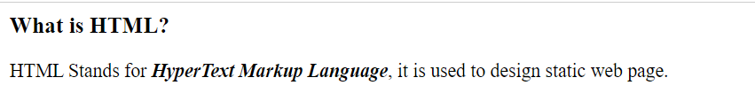
Introduction to Basic HTML Tags
HTML tags are like keywords which defines that how web browser will format and display the content.
Many elements have an opening tag and a closing tag — for example, a p (paragraph) element has a <p> tag, followed by the paragraph text, followed by a closing </p> tag.
Some elements don’t have a closing tag. These are called empty elements. For example, the br element for inserting line breaks is simply written <br>.
Now let’s look at some common tags used in html page:
<h1> to <h6> – Heading Tags: The <h1> to <h6> tags are used to define HTML headings. <h1> defines the most important heading. <h6> defines the least important heading.
<p> – Paragraph Tag: The <p> tag defines a paragraph. Browsers automatically add a single blank line before and after each <p> element.
<em> – Emphasized Tag: The <em> tag is used to define emphasized text. The content inside is typically displayed in italic.
<b> Tag: The <b> tag specifies bold text without any extra importance.
<br> Tag: The <br> tag inserts a single line break.

Slide 15
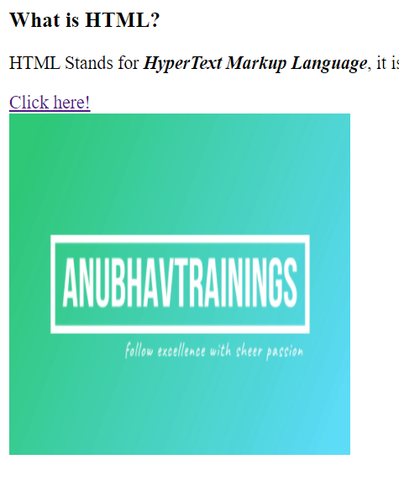
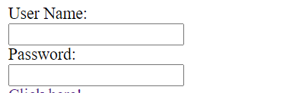
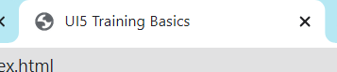
Basic HTML Tags Continue…
<title> – Title Tag: The <title> tag defines the title of the document. The title must be text-only, and it is shown in the browser's title bar or in the page's tab.
<meta> – Meta Tag: The <meta> tag defines metadata about an HTML document. Metadata is data (information) about data.
<a> – Anchor Tag: The <a> tag defines a hyperlink, which is used to link from one page to another. The most important attribute of the <a> element is the href attribute, which indicates the link's destination.
<img> – Image Tag: The <img> tag is used to embed an image in HTML Page.
<input> – Input Tag: The <input> tag specifies an input field where the user can enter data. The <input> element is the most important form element.
<label> – Label Tag: The <label> tag defines a label for several elements like <input> tag.

Slide 16
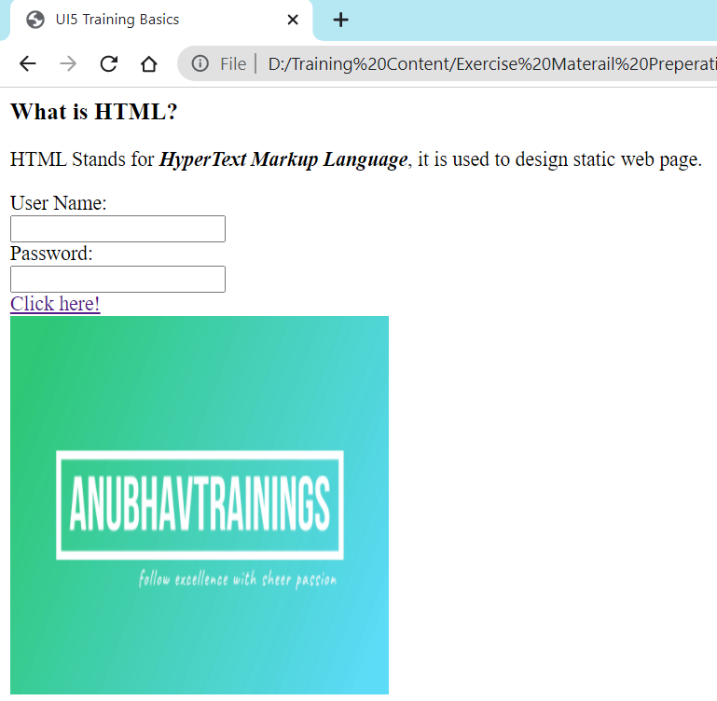
Hands – on: Basic HTML Tags
Create a simple HTML page using the basic HTML Tags like <h1> to <h6>, <p>, <em>, <b>, <img> and <a>.
Code Links:
index.html
image

Slide 17
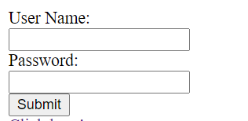
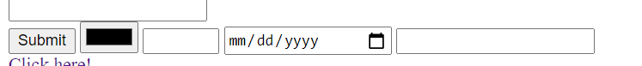
Form, Form Submit and Input Field Types
Form in HTML
The <form> element is a container for different types of input elements, such as: text fields, checkboxes, radio buttons, submit buttons, etc.
The HTML <form> element is used to create an HTML form for user input.
The user input is most often sent to a server for processing.
Submit Button
The <input type="submit"> defines a button for submitting the form data to a form-handler.
The form-handler is typically a file on the server or a web page with a script for processing input data.
The <input> Element
The HTML <input> element is the most used form element.
An <input> element can be displayed in many ways, depending on the type attribute.
Here are some examples:
<input type="color">
<input type="number">
<input type="date">
<input type="email">

Slide 18
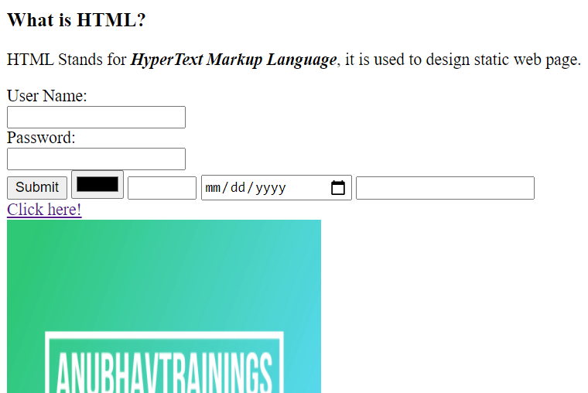
Hands – on: Form and Form Submit
Create a form using the input and label elements and also create a submit button using the input field of type submit.
Also check the different type of input field by changing the type attribute of the input tag.
You can check all the values in the type attribute on the w3c documentation for the input tag: https://www.w3schools.com/tags/tag_input.asp
Code Links:
index.html

Slide 19
Block Level and Inline Elements in HTML
Block Level Elements
A block-level element always starts on a new line.
A block-level element always takes up the full width available (stretches out to the left and right as far as it can).
A block level element has a top and a bottom margin, whereas an inline element does not.
The <div> element is a block-level element.
div – division tag – it is used to divide screen in multiple group of elements. Every div element always starts with new line.
Here are the some block-level elements in HTML:
<p> <div> <li> <hr> <video> <h1> to <h6> etc.,
Inline Elements
An inline element does not start on a new line.
An inline element only takes up as much width as necessary.
This is a <span> element inside a paragraph.
Here are the inline elements in HTML:
<a> <input> <button> <span> <textarea> etc.,
Block Level Elements
Element 1
Element 2
Element 3
Element 4
Inline Elements
Element 1
Element 2
Element 3
Element 4

Slide 20
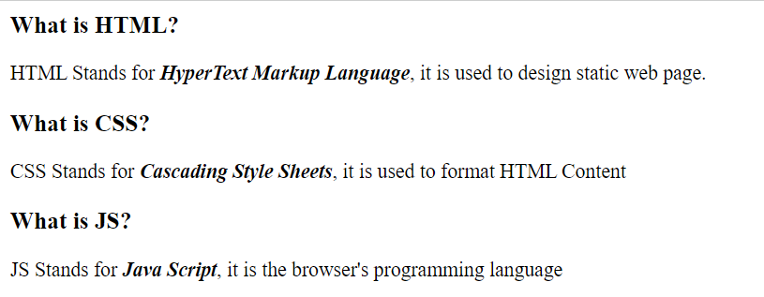
Hands – on: Block Level Elements
Now we will put the Heading and the definition of HTML, CSS and JS in different <div> tags, to demonstrate the block of content.
Code Link:
index.html

Slide 21
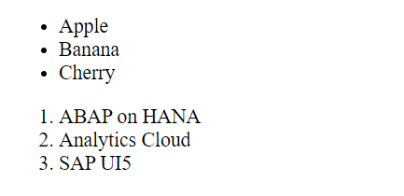
Ordered and Unordered List
HTML lists allow web developers to group a set of related items in lists.
Unordered HTML List:
An unordered list starts with the <ul> tag. Each list item starts with the <li> tag.
The list items will be marked with bullets (small black circles) by default.
Ordered HTML List:
An ordered list starts with the <ol> tag. Each list item starts with the <li> tag.
The list items will be marked with numbers by default.
An unordered HTML list:
Item
Item
Item
Item
An ordered HTML list:
First item
Second item
Third item
Fourth item
Hands – on: Ordered and Unordered List
Now we will create the ordered and unordered list in our web page using the <ul>, <ol> and <li> tags.
Code Link:
index.html

Slide 22
Introduction to Multimedia Tags in HTML
Multimedia on the web is sound, music, videos, movies, and animations.
Audio
The <audio> tag is used to embed sound content in a document, such as music or other audio streams.
The controls attribute adds video controls, like play, pause, and volume.
Video
The <video> tag is used to embed video content in a document, such as a movie clip or other video streams.
The controls attribute adds video controls, like play, pause, and volume.
Iframe
The <iframe> tag specifies an inline frame.
This is the easiest way to embed videos in HTML.
An inline frame is used to embed another document within the current HTML document.
We can also use <iframe> element to add YouTube videos in our web page.

Slide 23
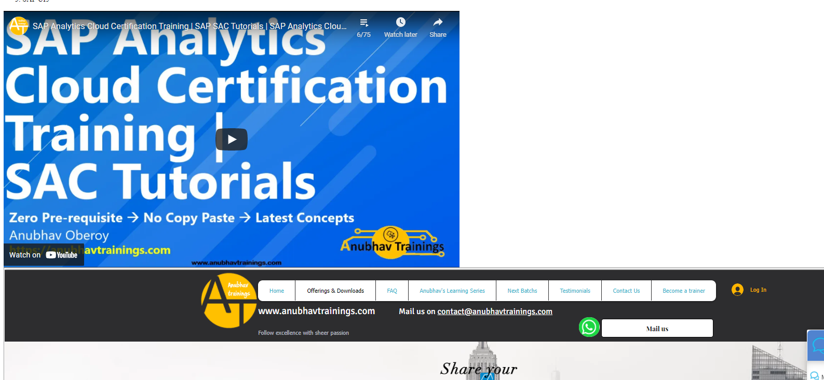
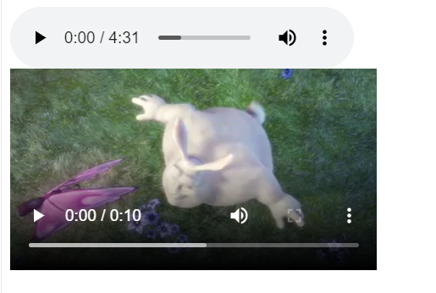
Hands – on: Multimedia Tags in HTML
Add the Multimedia elements to our web page using the audio, video and iframe tag.
Code Link:
index.html

Slide 24
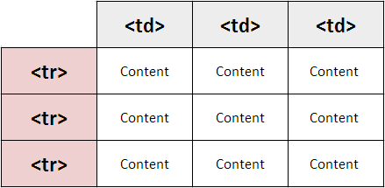
Introduction to Table element in HTML
HTML tables allow web developers to arrange data into rows and columns.
A table in HTML consists of table cells inside rows and columns
The <table> tag defines an HTML table.
An HTML table consists of one <table> element and one or more <tr>, <th>, and <td> elements.
The <tr> element defines a table row, the <th> element defines a table header, and the <td> element defines a table cell.
By default, the text in <th> elements are bold and centered, but you can change that with CSS.

Slide 25
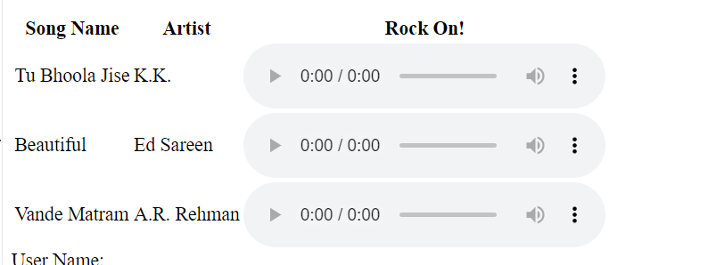
Hands – on: Table using HTML
Create a table in our HTML page using the <table> element and embed the audio tags in that table.
Code Links:
index.html

Slide 26

Agenda – After Break
Introduction to CSS
Inline style CSS
Internal style CSS
Concept of Box Model in CSS
Concept of Pseudo Classes in CSS
External style CSS
What is JavaScript?
Basic usage of JavaScript
Important Points about JavaScript
Variables and Data Types
Arrays and Objects in JS

Slide 27

Introduction to CSS
CSS Stands for Cascading Style Sheets, it is used to format/beautify the HTML content.
CSS describes how HTML elements are to be displayed on screen.
CSS saves a lot of work. It can control the layout of multiple web pages all at once.
We need CSS because HTML can only generate static content w/o coloring, formatting, borders, beautification.
Before css we have to use HTML tags for formatting which was very cumbersome
<p>I <b><color value=“red”>love</color></b><font val=“Calibri”>India<font></p>
There are 3 ways we can apply CSS on HTML Content
Inline CSS – applied at each element level <tagname style=“prop:val;prop:val;..”>….
Internal CSS – applied at the page level to target one or more than one html elements on the page. It is fully reusable.
External CSS – Where the CSS is applied by putting code in a reusable css file and later use the link tag to connect the same.

Slide 28
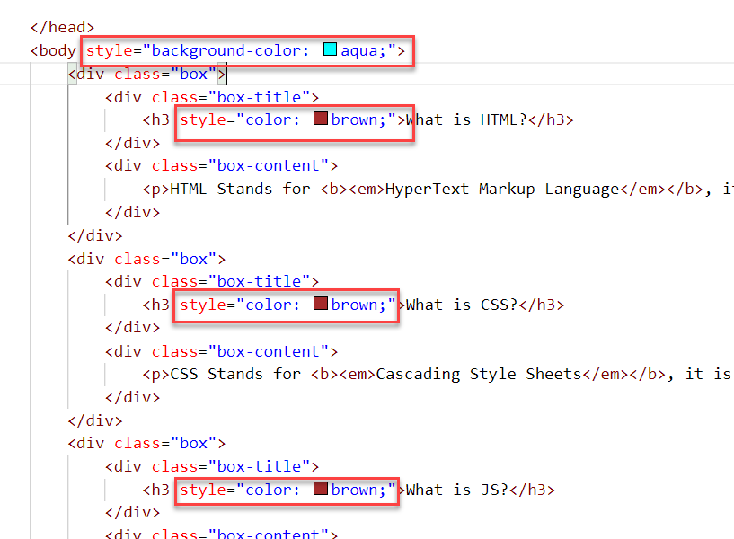
Inline CSS
Inline CSS is used to style a specific HTML element.
To apply Inline CSS add a style attribute to each HTML tag.
Inline styles in CSS could be useful for previewing changes instantly.
It can be useful when adding CSS rules to only one or two elements.
Syntax to apply Inline style CSS
<htmltag style="cssproperty1:value; cssproperty2:value;"> </htmltag>
We can see all the available CSS properties on the W3C:
https://www.w3schools.com/css/default.asp
Disadvantages of using Inline style CSS:
These styles cannot be reused anywhere else.
Adding CSS using this technique is time-consuming.
These styles are tough to be edited because they are not stored at a single place.

Slide 29
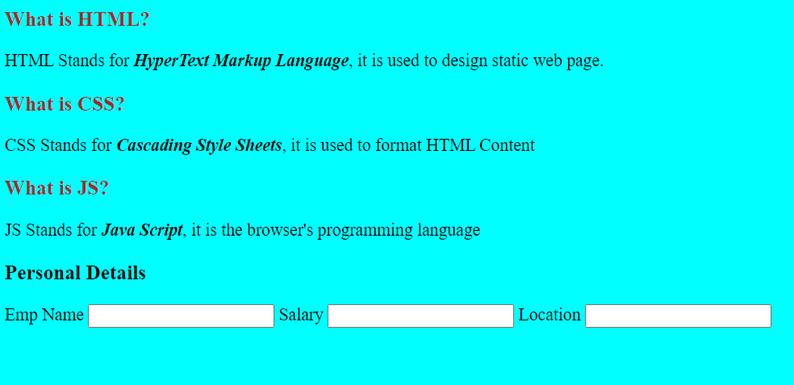
Hands – on: Inline CSS
Apply basic style to our html page using the Inline CSS technique.
For this exercise we will create a new file named cssbasics.html in our current folder.
Code Link:
cssbasics.html

Slide 30
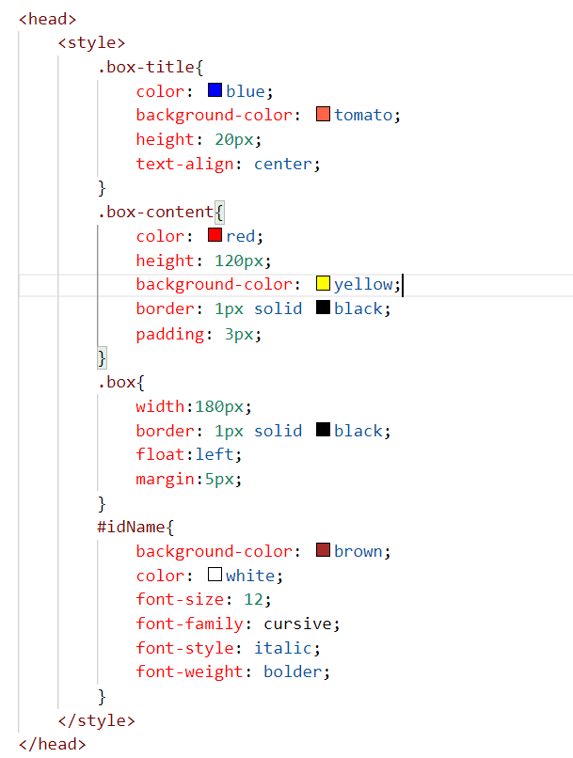
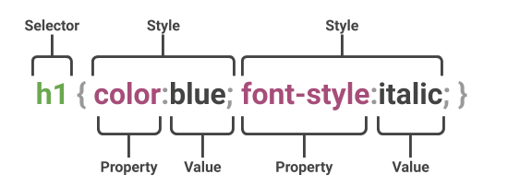
Internal CSS
The internal style sheet is used to add a unique style for a single document. It is defined in <head> section of the HTML page inside the <style> tag.
This CSS style is an effective way to style single pages.
Internal CSS is applied using the Selectors in the HTML page, which makes the styling easy.
Syntax to apply the Internal style CSS
<style>
selector{
propertyname: value;
propertyname: value;
}
</style>
Selector: CSS selectors are used to "find" (or select) the HTML elements you want to style.
The are three type of selectors in CSS.
#id: Id of the single element
.classname: group of elements which has same classification property
Tagname: group of elements which has same tag name

Slide 31
Box Model in CSS
In CSS, the term "box model" is used when talking about design and layout.
All HTML elements can be considered as boxes.
The CSS box model is essentially a box that wraps around every HTML element. It consists of: margins, borders, padding, and the actual content. The image below illustrates the box model:
margin
border
border
padding
Html element
Html element

Slide 32
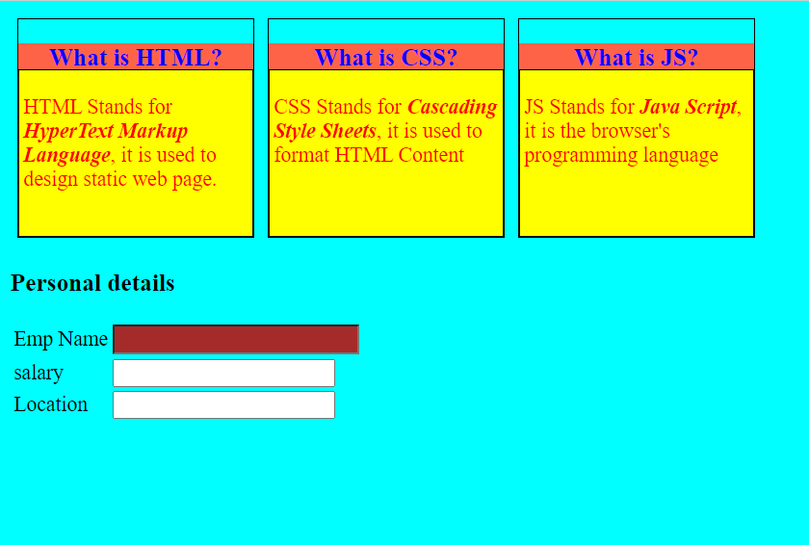
Hands – on: Internal CSS
Now will apply the CSS using the Internal style CSS to our block level elements (box and box-content), will also see how to use different types of selectors for styling the content.
We will also see some commonly used properties of CSS.
Code Links:
cssbasics.html

Slide 33
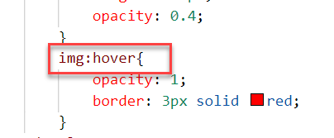
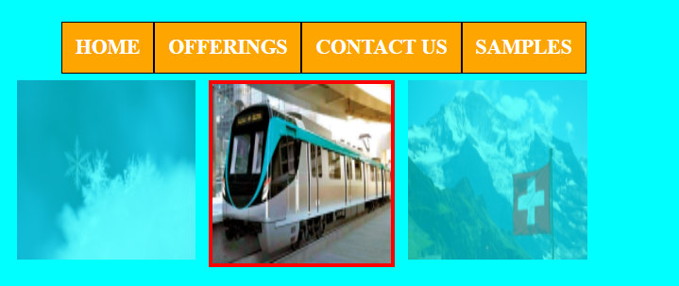
Pseudo-classes in CSS
A pseudo class is used to apply effects on the control based on special conditions or activity.
For example, it can be used to:
Style an element when a user mouses over it
Style visited and unvisited links differently
Style an element when it gets focus
Syntax to use pseudo class
selector:pseudo-class { property: value; }

Slide 34
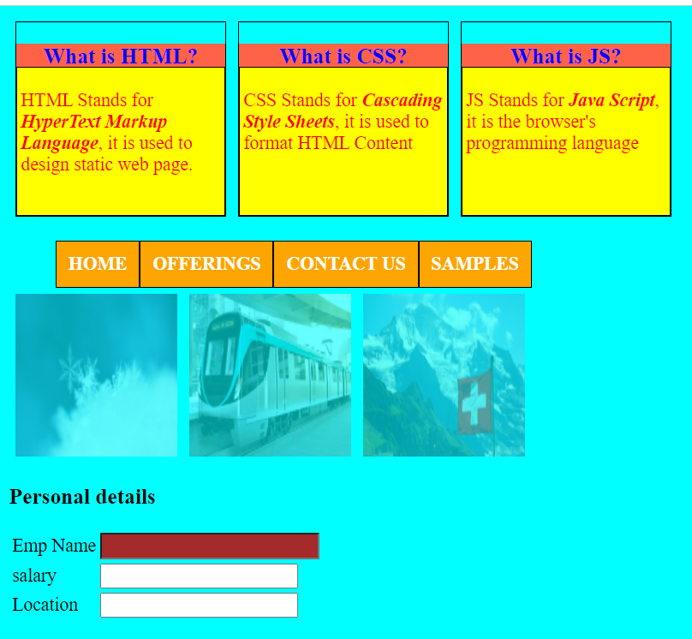
Hands – on: Pseudo Classes in CSS
Add three images and style them using the hover class of CSS. So when we hover the mouse on the image gets highlighted.
Also create a Navbar in our HTML Page.
In this exercise we will also see how to apply styling on the child elements using the parent element..
Code Links:
cssbasics.html

Slide 35
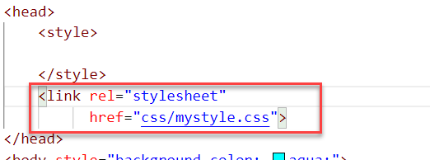
External CSS
In external CSS, we link the web pages to the external .css file.
This CSS type is a more efficient method, especially for styling a large website. By editing one .css file, you can change your entire site at once.
Since the CSS code is in a separate document, your HTML files will have a cleaner structure and are smaller in size.
An external style sheet can be linked to an HTML document using the <link> tag. The <link> tag goes inside the <head> section.

Slide 36
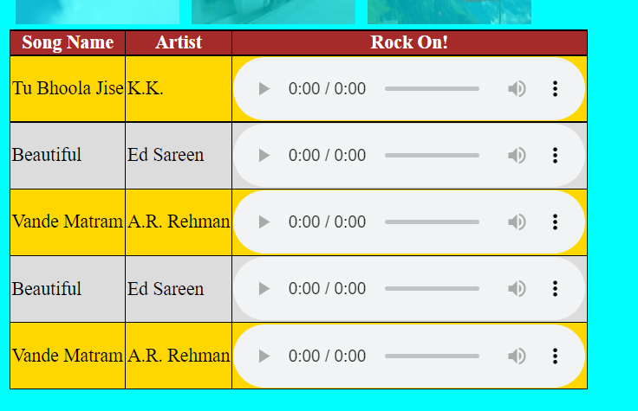
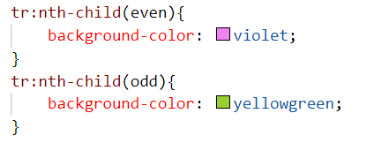
Hands – on: External CSS
Now we will use the External style CSS to style our HTML page.
We will also style our table element to demonstrate the concept of styling the child elements.
Exercise code:
cssbasics.html
mystyle.css

Slide 37

End of Day 1

Slide 38

Questions

Slide 39

Shekhar Vedi

Slide 40


We’re committed to empower you to be
Most Desirable Resource
through powerful training solutions.
We build the workforce of the future.
250+
Corporate Clients
30,000+
Learners Trained
25000+
Learners Placed
FREE WEBINARS
Sign up for free webinars with industry experts every fortnight!
Enroll Now!
Contact us today!
https://anubhavtrainings.com/

Slide 41




More from AnubhavTrainings.com

Slide 42
Title
Content

